Slide 1

Chapter 14: Partial Derivatives
Section 14.1: Functions of Several Variables

Slide 2


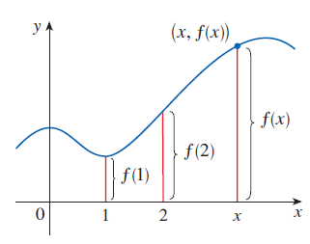
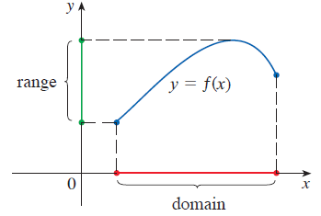
of a Single Variable
of a single variable

Slide 3

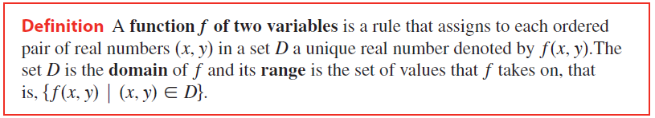

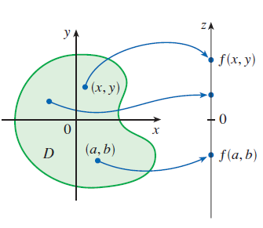
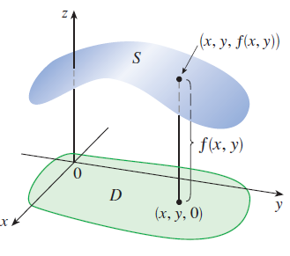

Slide 4
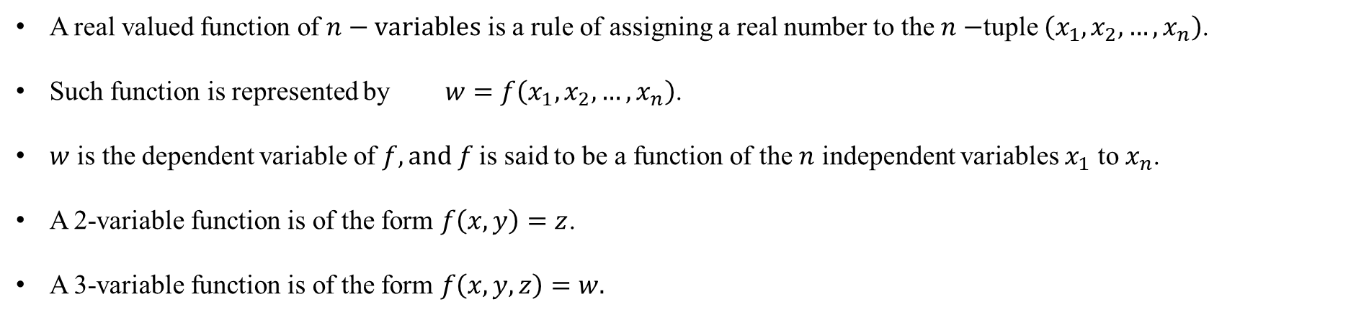
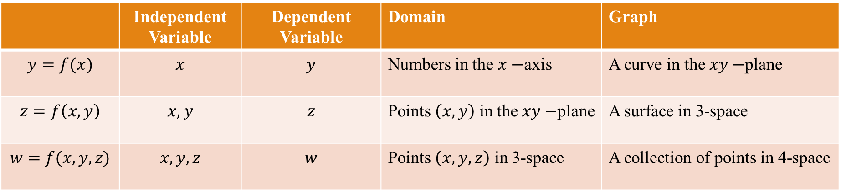
A real valued function of $n−variables$ is a rule of assigning a real number to the $n−$tuple $\left(x_{1}, x_{2}, …,x_{n}\right)$.
Such function is represented by $w=f\left(x_{1}, x_{2}, …, x_{n}\right)$.
$w$ is the dependent variable of $f, and f$is said to be a function of the $n$ independent variables $x_{1}$ to $x_{n}$.
A 2-variable function is of the form $f\left(x,y\right)=z$.
A 3-variable function is of the form $f\left(x, y, z\right)=w.$
 | Independent Variable | Dependent Variable | Domain | Graph
$$y=f(x)$$ | $$x$$ | $$y$$ | Numbers in the $x−$axis | A curve in the $xy−$plane
$$z=f\left(x,y\right)$$ | $$x, y$$ | $$z$$ | Points $\left(x, y\right)$ in the $xy−$plane | A surface in 3-space
$$w=f(x, y, z)$$ | $$x, y, z$$ | $$w$$ | Points $\left(x, y, z\right)$ in 3-space | A collection of points in 4-space

Slide 5
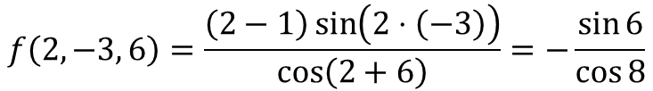
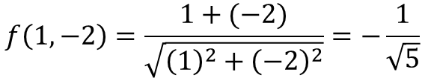
Calculate $f\left(1, −2\right)$ where $f\left(x, y\right)=\frac{x+y}{\sqrt{x^{2}+y^{2}}}$
$$f\left(1, −2\right)=\frac{1+(−2)}{\sqrt{{\left(1\right)}^{2}+{\left(−2\right)}^{2}}}=−\frac{1}{\sqrt{5}}$$
Calculate $f\left(2, −3, 6\right)$ where $f\left(x, y, z\right)=\frac{\left(x−1\right)\sin\left(xy\right)}{\cos\left(x+z\right)}$
$$f\left(2, −3, 6\right)=\frac{\left(2−1\right)\sin\left(2⋅\left(−3\right)\right)}{\cos\left(2+6\right)}=−\frac{\sin{6}}{\cos{8}}$$

Slide 6

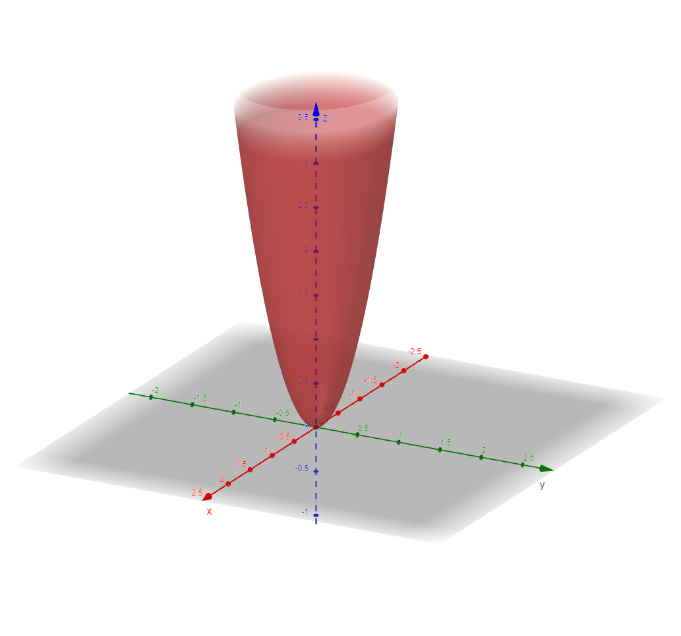
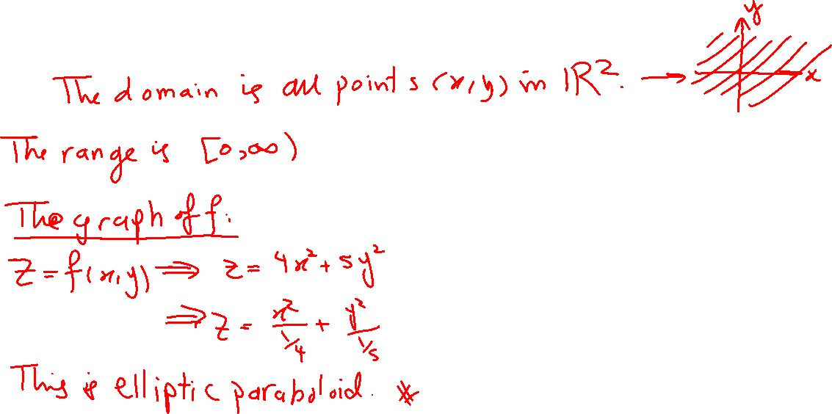
Find the domain and range of the function $f\left(x, y\right)=4x^{2}+5y^{2}.$ Sketch the domain and the function.
Domain: $D=\left\{\left(x,y\right); x∈ℝ, y∈ ℝ\right\}$ i.e. the entire $xy−$plane. Range$=\left[0, ∞\right)$. The graph of the function is elliptic paraboloid with vertex $\left(0, 0, 0\right)$ and open upward with its axis is the $z$-axis.

Slide 7
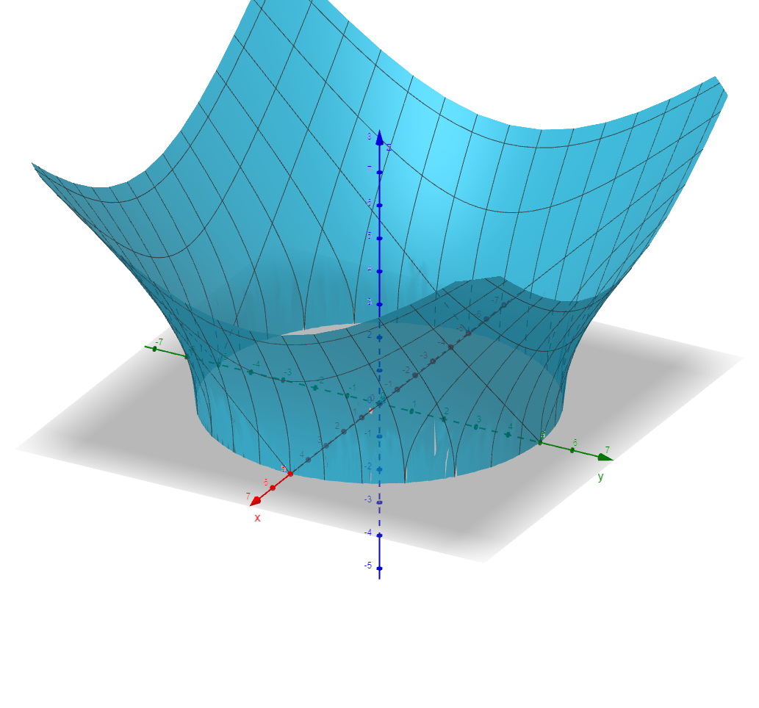
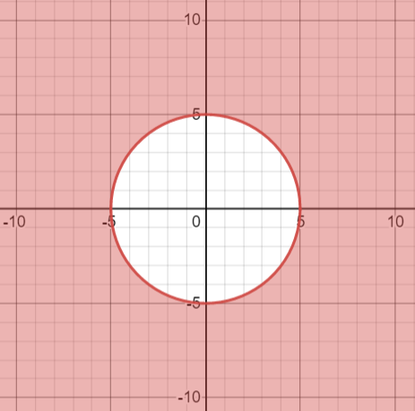
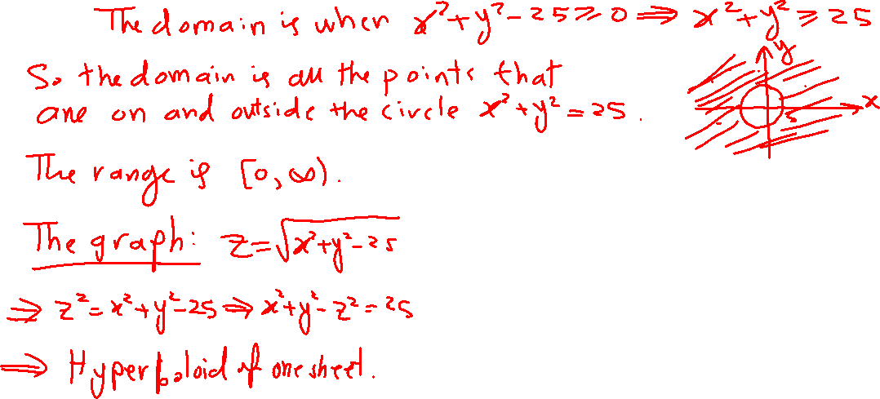
Find the domain and range of the function $f\left(x, y\right)=\sqrt{x^{2}+y^{2}−25}.$ Sketch the domain and the function.
Domain: $D=\left\{\left(x, y\right);x^{2}+y^{2}≥25\right\}.$Range $=\left[0, ∞\right)$. The graph of the function is the upper half of hyperboloid of one sheet.

Slide 8
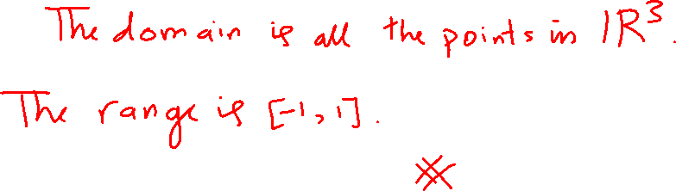
Find the domain and range of the function $f\left(x, y, z\right)=\cos\left(x−2y+z^{2}\right).$
The domain is the entire 3-space. Range $=\left[−1, 1\right]$

Slide 9
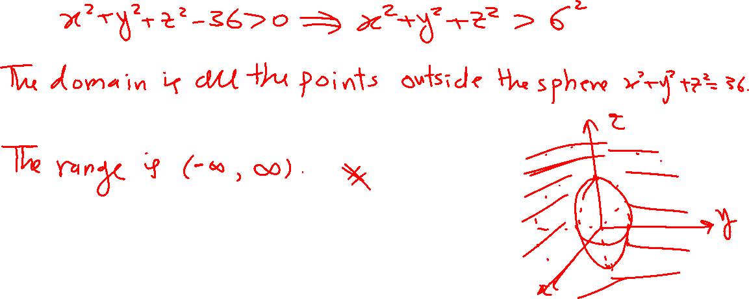
Find the domain and range of the function $f\left(x, y, z\right)=\ln\left(x^{2}+y^{2}+z^{2}−36\right).$ Sketch the domain.
Domain: $D=\left\{\left(x, y, z\right);x^{2}+y^{2}+z^{2}>36\right\}.$Range $=\left(−∞, ∞\right)$

Slide 10
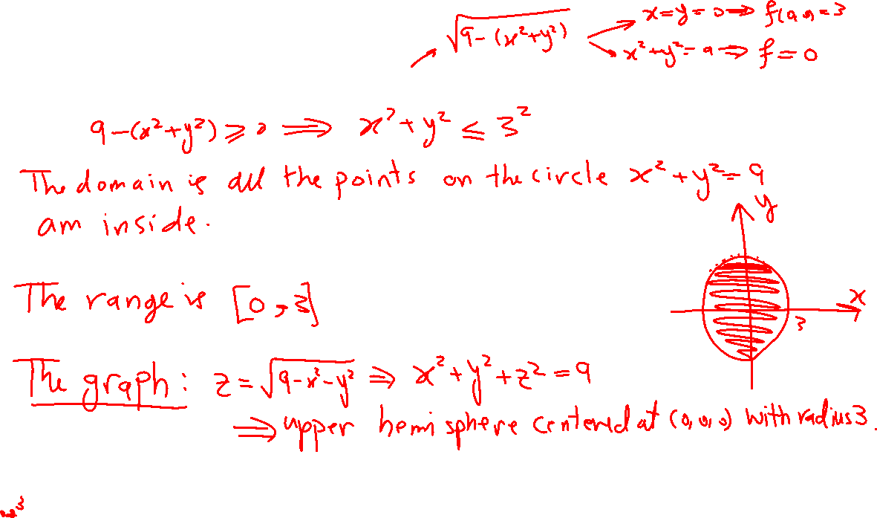
Find the domain and range of the function $f\left(x, y\right)=\sqrt{9−x^{2}−y^{2}}.$ Sketch the domain and the function.
Domain: $D=\left\{\left(x, y\right);x^{2}+y^{2}≤9\right\}.$Range $=\left[0, 3\right]$. The graph of the function is the upper hemisphere (half sphere) of radius 6 centered at the origin.

Slide 11
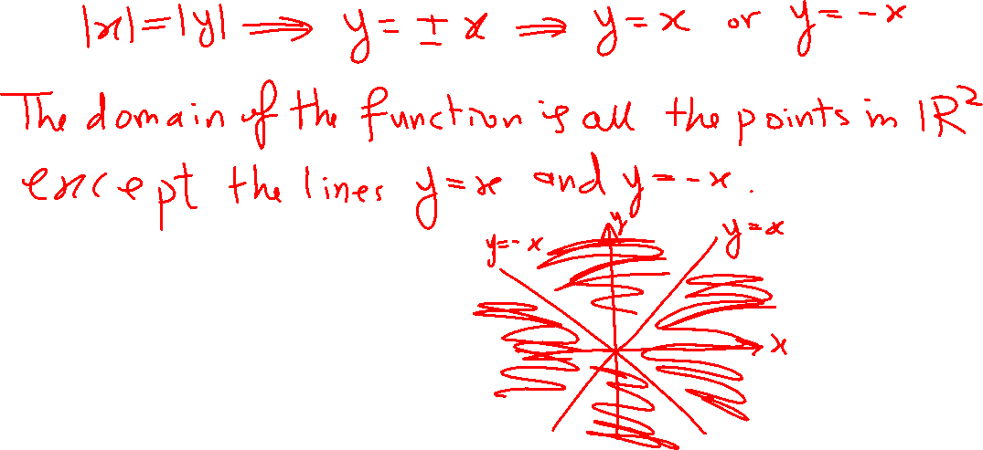
Find the domain of the function $f\left(x, y\right)=\frac{1}{\left|x\right| −\left|y\right|}.$ Sketch the domain.
Domain: $D=\left\{\left(x, y\right);y≠±x\right\}=$ all the points $\left(x, y\right)$ that are not on the lines $y=x$ and $y=−x$.

Slide 12

Find the domain of the function $f\left(x, y, z\right)=\frac{1}{2− \sqrt{7−x^{2}−y^{2}−z^{2}}}.$
Domain: $D=\left\{\left(x, y, z\right); x^{2}+y^{2}+z^{2}≤7 and x^{2}+y^{2}+z^{2}≠3\right\}$.

Slide 13

Find the domain and range of the function $f\left(x, y\right)=e^{x^{2}+y^{2}+1}.$
Domain: The entire $xy−$plane. Range $=\left[e, ∞\right)$

Slide 14
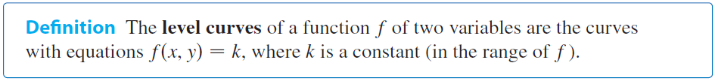
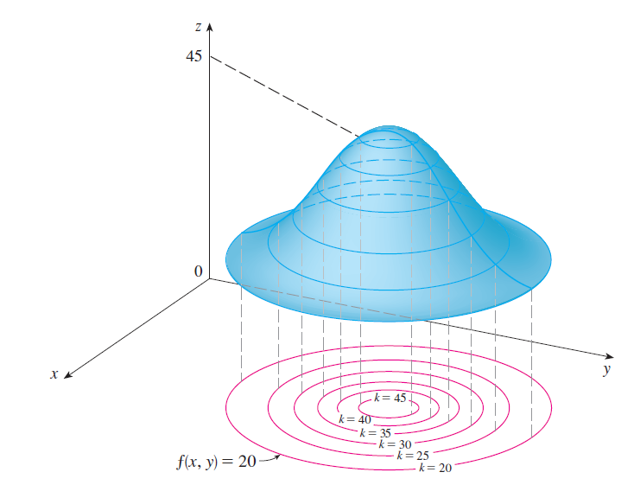
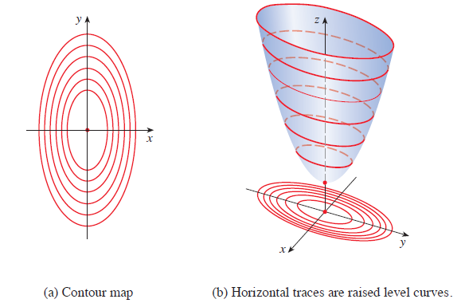
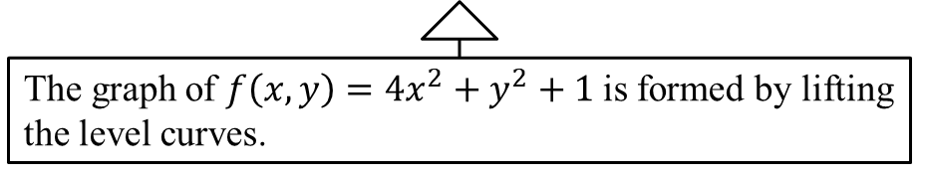
A collection of the level curves on the $xy−$plane is called contour maps.
The graph of $f\left(x,y\right)=4x^{2}+y^{2}+1$is formed by lifting the level curves.

Slide 15

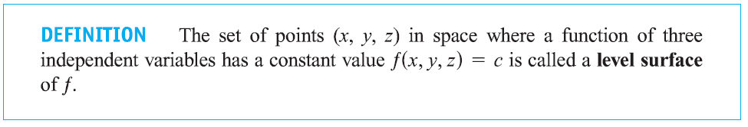
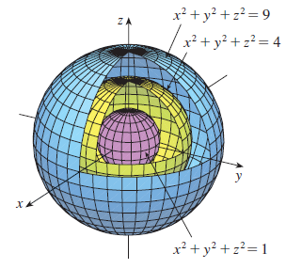
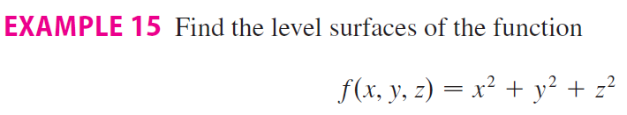

Slide 16
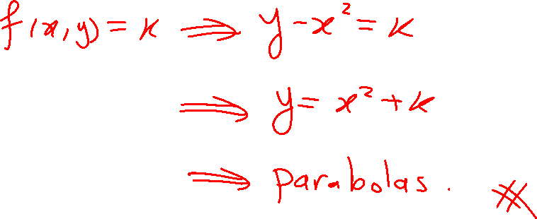
D$escribe the level curves of f\left(x, y\right)=y−x^{2}.$
The level curves are parabolas of the form $y=x^{2}+c$.

Slide 17
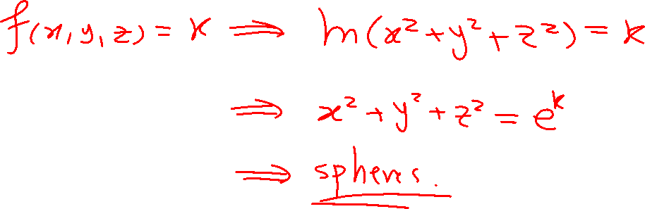
D$escribe the level surfaces f\left(x, y, z\right)=\ln\left(x^{2}+y^{2}+z^{2}\right).$
The level surfaces are spheres of the form $x^{2}+y^{2}+z^{2}=e^{c}$

Slide 18

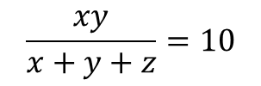
L$et f\left(x, y, z\right)=\frac{xy}{x+y+z}.$ Find an equation for the level surface of $f$ that passes through the point $\left(4, 5, −7\right).$
$$\frac{xy}{x+y+z}=10$$

Slide 19
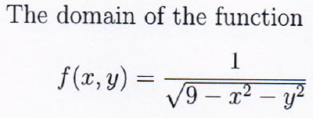
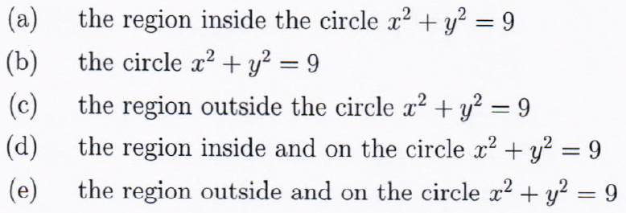

Slide 20

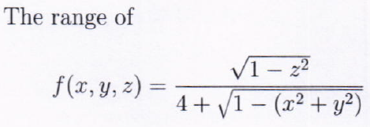

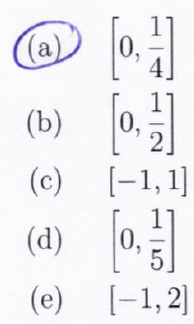

Slide 21

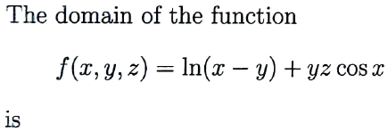
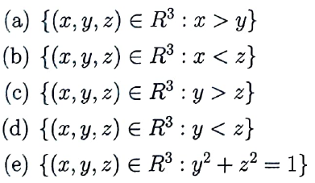
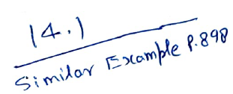

Slide 22
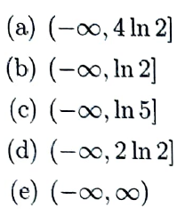
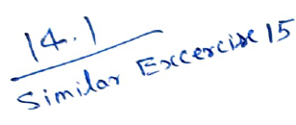

Slide 23
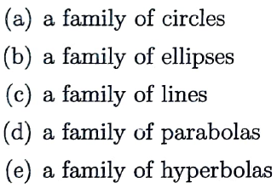
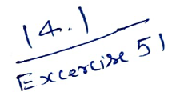

Slide 24
Solve exercises of section 14.1.
Start with the suggested problems mentioned in the syllabus.

